Slide 1
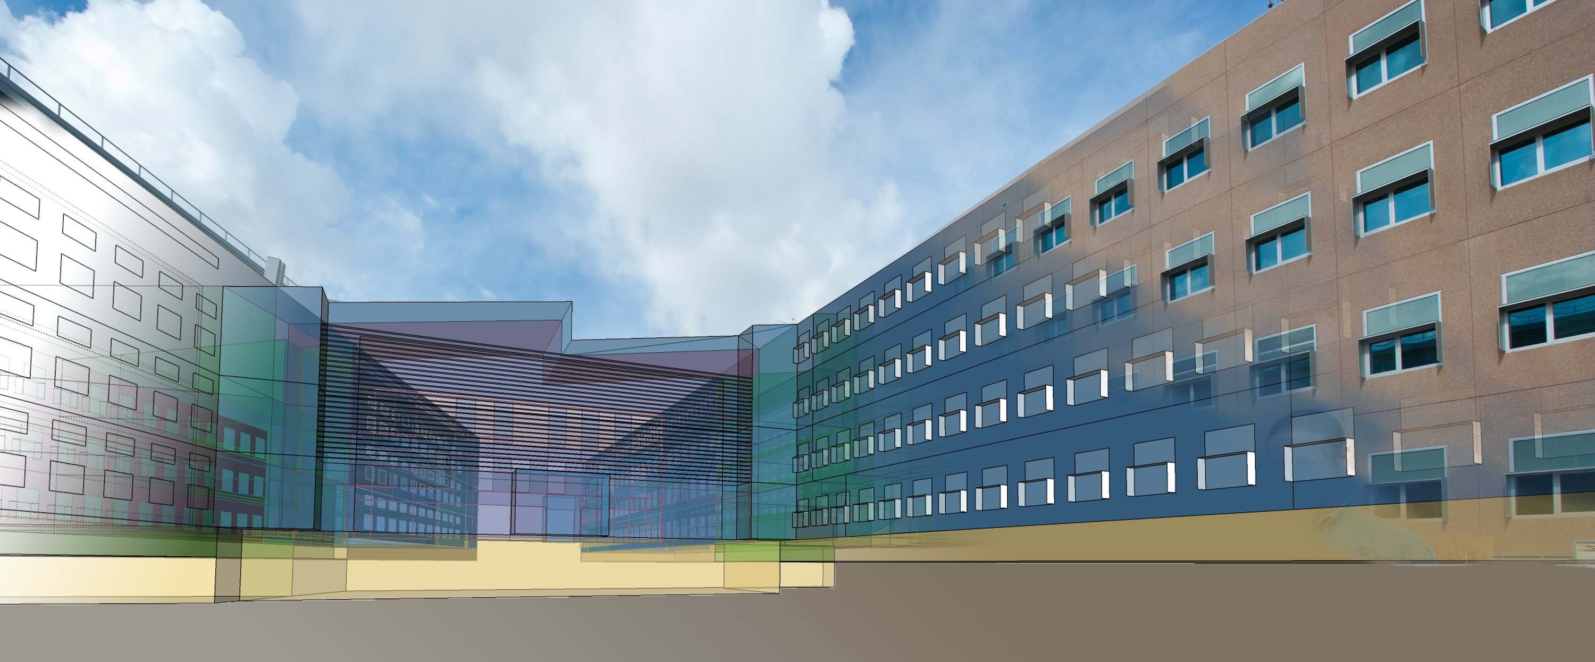
ESI Campus Modeling Platform
July 16, 2012

Slide 2
Virtual-Campus modeling Framework
BEMscape
OPAL RT
Chiller
Building 1 Load
Building 1 Load
Electrical Loop
BAS
(delta)
B1
Building 2 Load
Building 2 Load
B2
.
.
.
Heating loop
Control layer
Cooling loop
Building N Load
Building N Load
Electrical monitoring
PV1
PV2
Thermal
Central
Plant
EV1
Power
Site
Generation
EV2
Load
Ball
Electric Vehicles
Simulink Development Server
Various
Users
Brackney
Chakraborty
Weather, Utility Rate, etc.
Kramer
.
.
.
Timestep, Modified Schedules, etc.

Slide 3
Virtual-Campus modeling Framework
BEMscape
OPAL-RT, OP5600 HIL Box
Chiller
Building 1 Load
Building 1 Load
Electrical Loop
SimPowerSystems
BAS
(delta)
B1
Building 2 Load
Building 2 Load
B2
Heating loop
.
.
.
RT-LAB Orchestra API / OPC Server
RT-LAB Orchestra API
Cooling loop
SimScape
Building N Load
Building N Load
Electrical monitoring
PV1
PV2
Thermal
Central
Plant
EV1
Power
Site
Generation
EV2
Load
RT-LAB Host Workstation
12 core, Dell T7500 48GB
Ball
Electric Vehicles
Various
Matlab
Simulink
SimScape
SimPowerSystems
Simulink Coder
Matlab Coder
Visual Studio
Users
Brackney
Chakraborty
Weather, Utility Rate, etc.
Kramer
.
.
.
Timestep, Modified Schedules, etc.

Slide 4
Virtual-Campus modeling cost
Required components
Option 1
Option 2
OPAL-RT Hardware
OP5600 HIL Box (6cores) $13,147
Reconfig FPGA I/O system $11,624
Host Computer Hardware
Dell T7500 12core , 2.4GHz $9,000
48 GB RAMM, 3 1TB RAID 5 HDs
Host Computer Hardware
Dell T7500 8core , 2.13GHz $6,000
24 GB RAMM, 3 1TB RAID 5 HDs
OPAL-RT Software
RT-Lab Host license $10,063
RT-Lab HIL Target License(1core)$22,217
RT-Lab Orchestra License $4,448
Mathwork/Other Software
MATLAB (x1) $1,935
Simulink (x1) $2,925
Simscape (x1) $1,800
SimPowerSystems (x1) $2,700
Simulink Coder (x1) $2,925
Matlab Coder (x1) $5850
Visual Studio (x1) $500
subtotal: $18,635
Mathwork/Other Software
MATLAB (x2) $3,870
Simulink (x2) $5,850
Simscape (x2) $3,600
SimPowerSystems (x1) $2,700
Simulink Coder (x1) $2,925
Matlab Coder (x1) $5,850
Visual Studio (x1) $500
subtotal: $25,295
OPAL-RT misc
Onsite training 2days $2,649
Shipping & Handling $1,995
OPAL-RT subtotal $66,143
Possible Future Additions
RT-Lab OPC Server $10,000
KepWare LinkMaster $1,000
WonderWare Info Server Client ??
Extra I/O cards for HIL, Cables ??
Extra RT-Lab Target core licenses??
Platform total: $100,438
Platform total: $90,778
This option includes an extra
Simulink/Simscape license for model
Development off the Host workstation.
This option includes only licenses for
Host workstation and target HIL box.
All model development done directly on
The Host computer.

